Slide 1
TNSDC – Machine Learning to Generative AI
Name : S.P. Jashwanth
Reg.No : 410121104048
NM ID : au410121104048
Department : Computer Science Engineering
Topic : TNSDC – Machine Learning to Generative AI
Project Name : Face detection using CNN algorithm.

Slide 2
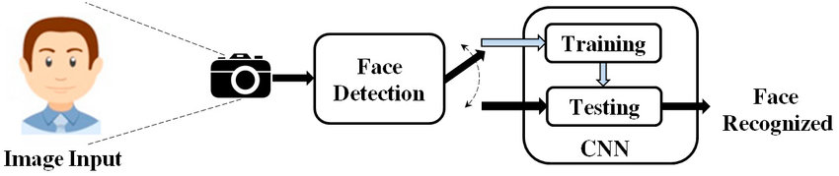
Face detection using CNN algorithm.
3/21/2024 Annual Review

Slide 3


AGENDA
Problem Statement
Proposed System / Solution
System Development Approach
Algorithm
Deployment
Result
Conclusion
3/21/2024 Annual Review

Slide 4

PROBLEM STATEMENT
Develop a system capable of accurately detecting human faces in images or video streams. This system should be robust to variations in lighting conditions, facial expressions, and orientations.

Slide 5

Proposed System / Solution
Utilize Convolutional Neural Networks (CNNs), a type of deep learning algorithm well-suited for image recognition tasks. Train the CNN on a dataset of labeled facial images to learn distinctive features of human faces. Implement techniques such as data augmentation and transfer learning to enhance model performance.

Slide 6

System Development Approach
Data Collection: Gather a diverse dataset of facial images covering various demographics, poses, and environmental conditions.
Data Preprocessing: Resize images, normalize pixel values, and perform data augmentation techniques like rotation, flipping, and brightness adjustment.
Model Training: Design and train a CNN architecture using frameworks like TensorFlow or PyTorch. Experiment with different network architectures, hyperparameters, and optimization techniques to achieve optimal performance.
Evaluation: Evaluate the trained model on a separate validation dataset to measure its accuracy, precision, recall, and F1-score.
Deployment: Integrate the trained model into a software application or system capable of real-time face detection.

Slide 7
Algorithm
CNNs consist of multiple layers, including convolutional, pooling, and fully connected layers. Convolutional layers extract features from input images by applying learnable filters. Pooling layers reduce spatial dimensions, while fully connected layers classify extracted features. The model learns to detect faces by adjusting the parameters of these layers during training via backpropagation.

Slide 8

Deployment
Deploy the trained model in a production environment, such as a mobile app, web service, or standalone application. Ensure efficient inference speed and minimal resource requirements for real-time face detection.

Slide 9
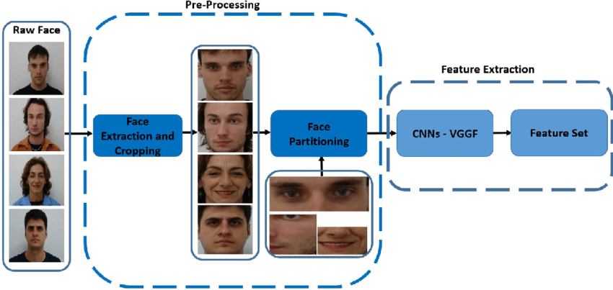

Result
Measure the performance of the deployed face detection system using metrics like accuracy, speed, and robustness. Conduct real-world testing to assess its effectiveness in various scenarios and environments.
3/21/2024 Annual Review
‹#›

Slide 10
Conclusion
Face detection using CNNs offers a promising solution for automating the task of identifying human faces in images or videos. By leveraging deep learning techniques, the proposed system achieves high accuracy and robustness, making it suitable for applications in security, surveillance, biometrics, and human-computer interaction. Further research could focus on improving the efficiency and scalability of the system, as well as extending its capabilities to detect facial attributes and emotions.
‹#›

